Slide 1
Python Data Analytics Project Employee Attrition Problem Project Report
- Chiranjibi Ghimire

Slide 2
Research Questions
WHY EMPLOYEE ARE PRONE TO LEAVE AFTER ANALYSING THIS DATA SET?
WHAT TYPE OF EMPLOYEE ARE PRONE TO LEAVE THE COMPANY?
PREDICT THE FUTURE EMPLOYEE WHO WOULD TEND TO LEAVE THE COMPANY.

Slide 3
Methodology
In order to answer the research questions, I will follow below data analysis techniques.
Data cleaning
Data Exploration
Data Visualization
Data Modeling
Feature Selection
Result Interpretation

Slide 4
Data DESCRIPTION
The given data set contains two excel sheets, one is for existing employees and other for ex-employees. The existing employee data set has 11428 rows and 10 columns and ex-employee data set has 3571 rows and 10 columns. That means, there are 3571 employees left the company and 11428 employees stayed in company.
Both data sets are clean, no missing values. So, I will move to the data exploration process to study more about the data set.

Slide 5
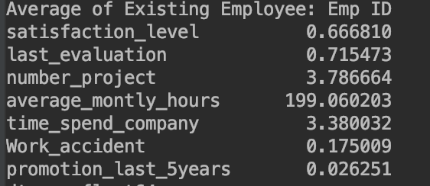
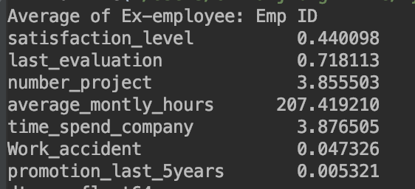
Data exploration
Let us get average of numerical columns. Below are several findings:
The average satisfaction level of existing employees is higher than that of the employees who left.
The average monthly work hours of employees who left the company is more than that of the employees who stayed.
Existing Employees
Ex-employees

Slide 6
Data exploration Contd..
According the data exploration table (previous slide), the employees who were promoted in last five years are less like to leave the company than those who didn’t get promotion.

Slide 7
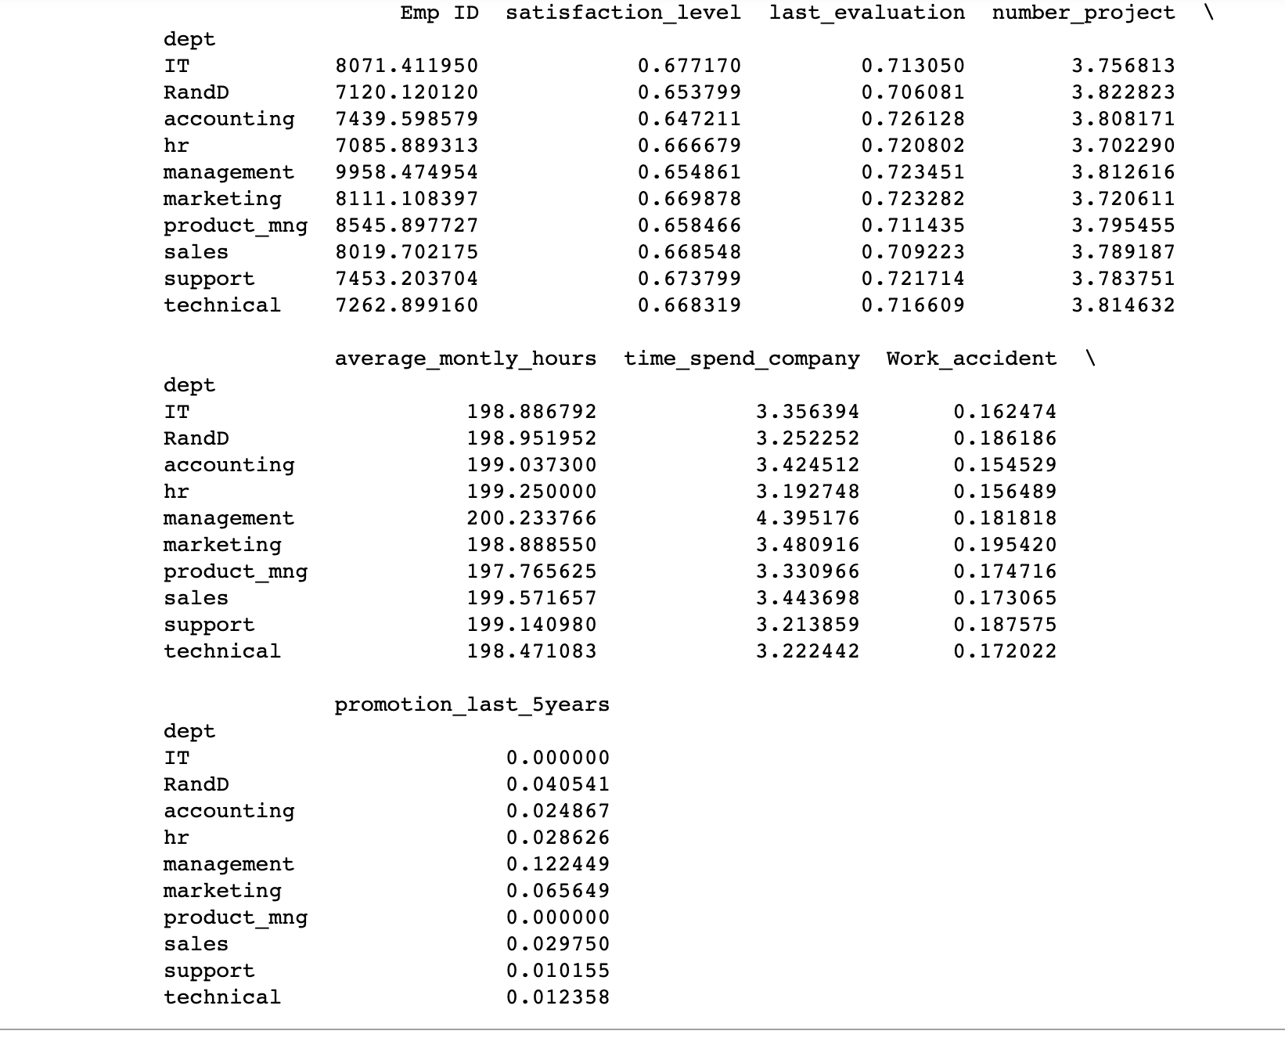
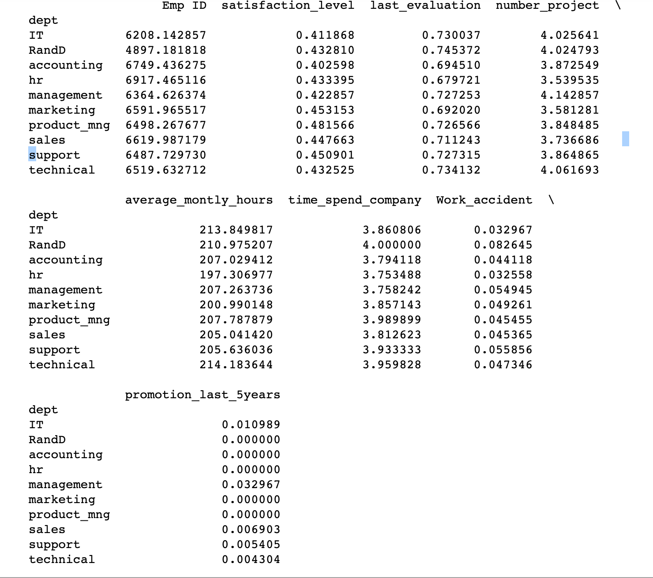
Data exploration Contd..
Now, we can calculate the categorical mean of categorical variables ‘dept’ and ‘salary’ to get more sense of the data.
The satisfaction level of current employees is high across all the departments

Slide 8
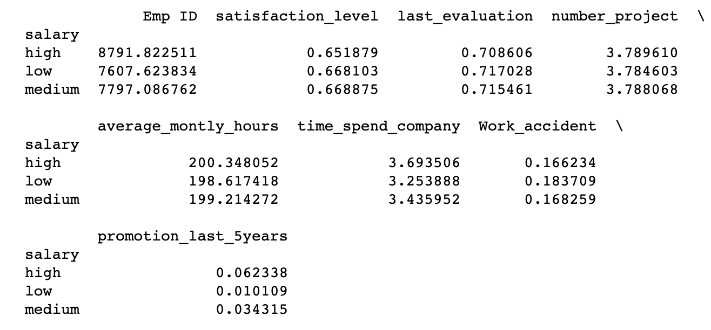
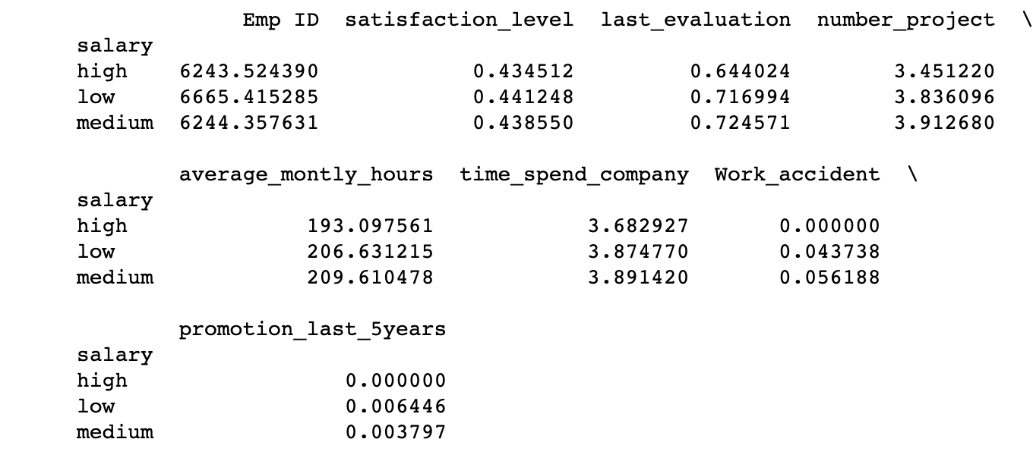
Data exploration Contd..
The satisfaction level for all salary level is almost similar for current employees. However, current employees with high salary works more hours than other salary level.
The satisfaction level of ex-employees is similar for all salary level, where as the medium and low salary employees worked more hours than high salary employees.
Existing Employees
Ex-employees

Slide 9
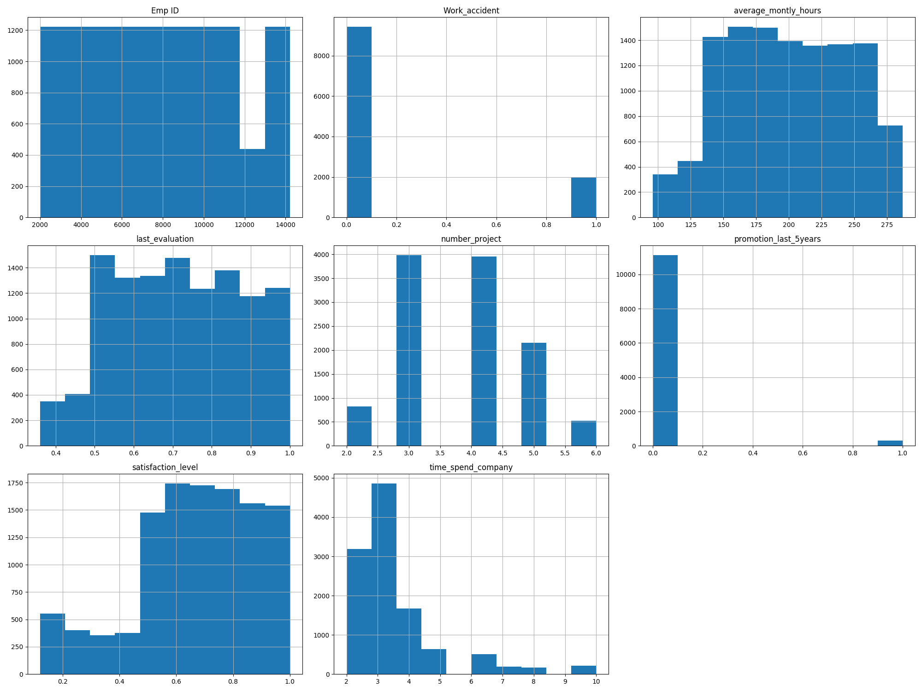
Data Visualization
We can visualize the data to get more detail about data set.
Histogram of Existing Employees

Slide 10
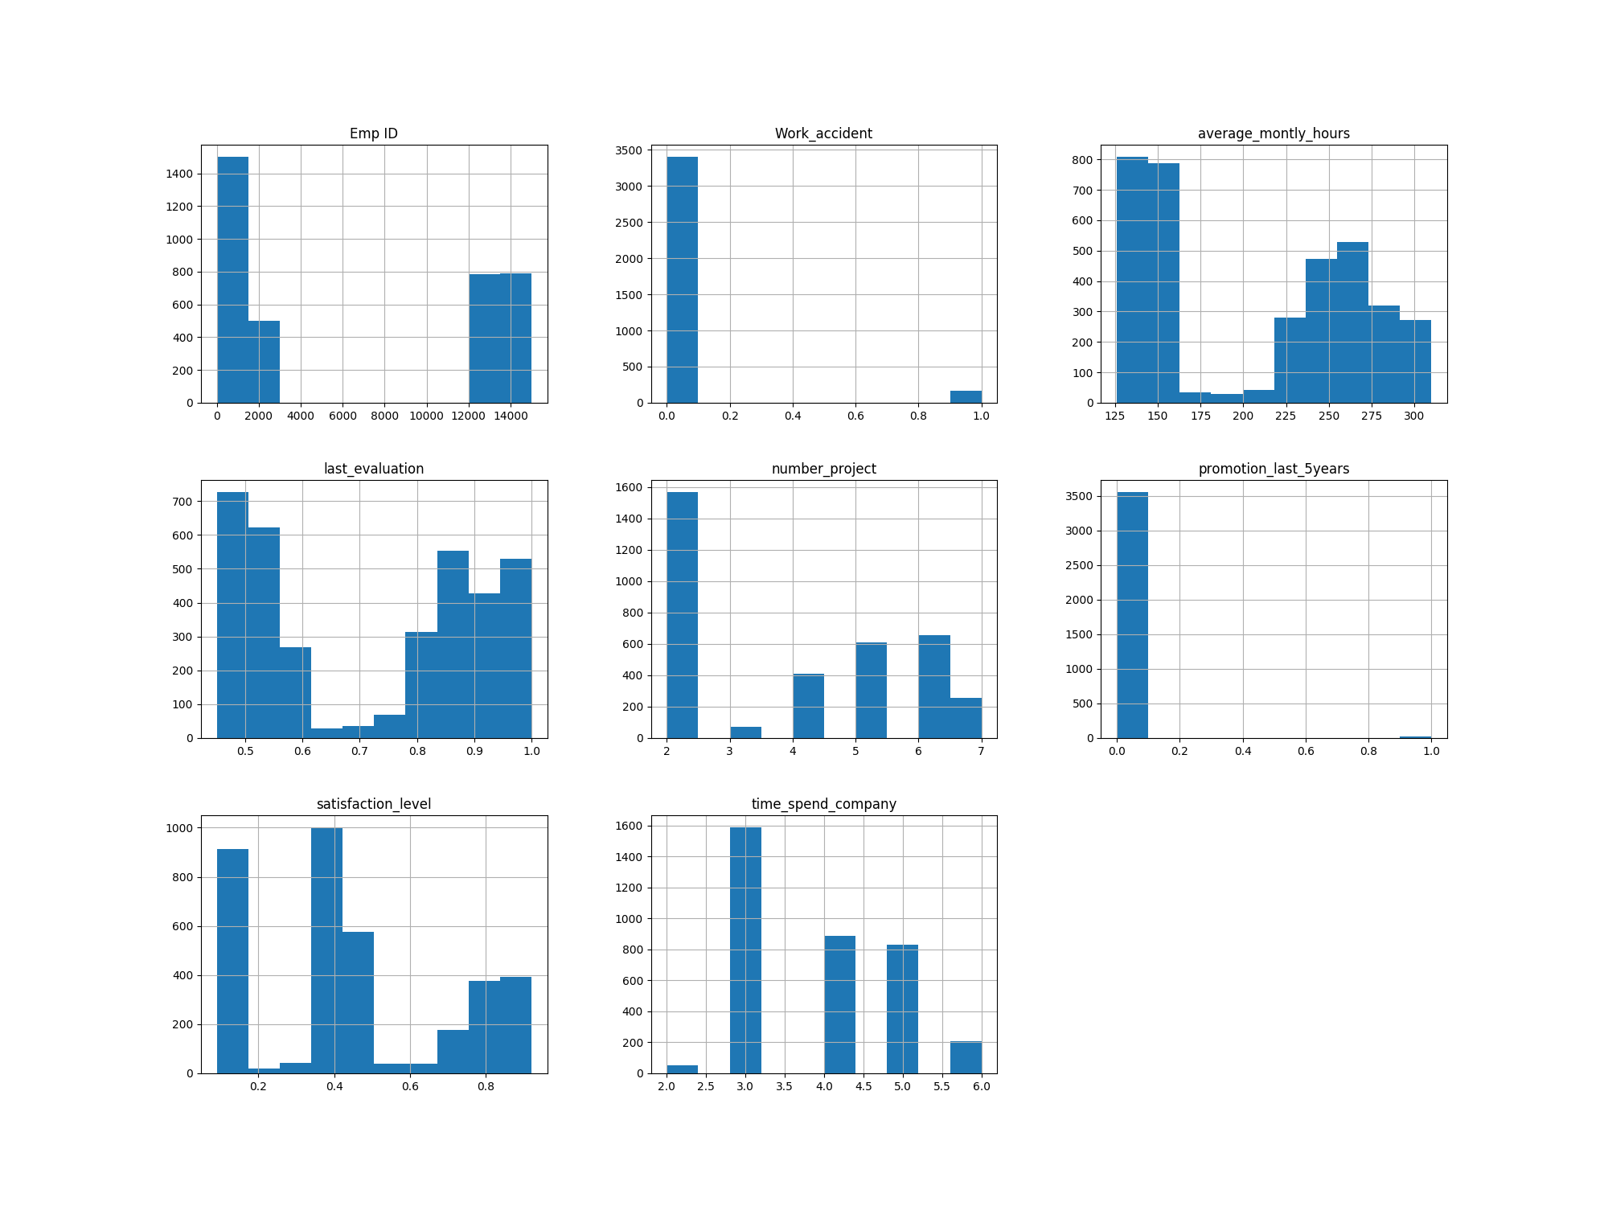
Data Visualization
It looks like there is a more discrepancy in promotion and satisfaction level between existing and ex-employees data set.
Histogram of nonexisting Employees

Slide 11
Data modeling
We can model the data set by removing some less significant variables. We can calculate the accuracy to identify the most significant variables to predict the employees who tend to leave.
We can use various modeling approach such as linear regression, random forest, support vector machine to predict the employees who likely to leave the company.

Slide 12
Results
Employees are more likely to leave the company because of low satisfaction level, low rate of promotion, inconsistent monthly work hours, and inconsistent last evaluation. Due to the low satisfaction level, they spent less time in company in comparison to existing employees.
We could use feature selection process and some data modeling algorithms to predict the employee who tend to leave the company. I will present details in the final report.

